Slide 1
ELEC 4727/5727
Computer Vision & Image Processing
Lecture 2
Basics of an Image

Slide 2
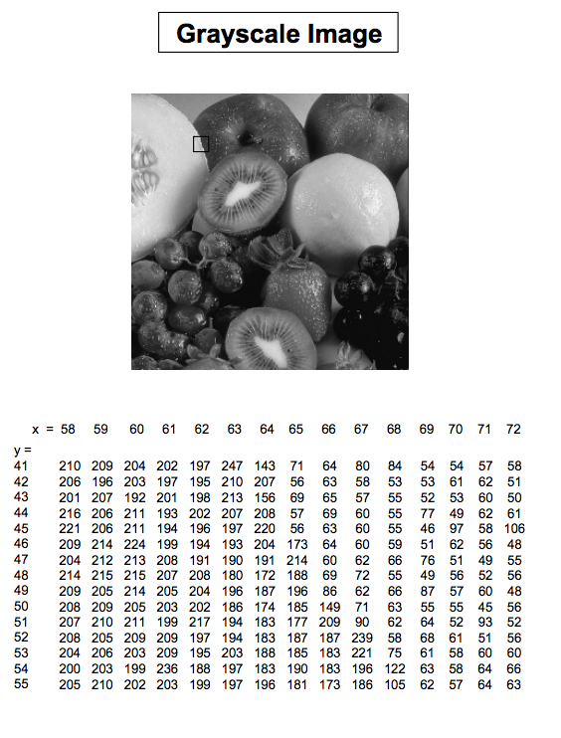
Pixel
Basic relationships between pixels
Neighborhood
Adjacency
Connectivity
Regions and boundaries

Slide 3
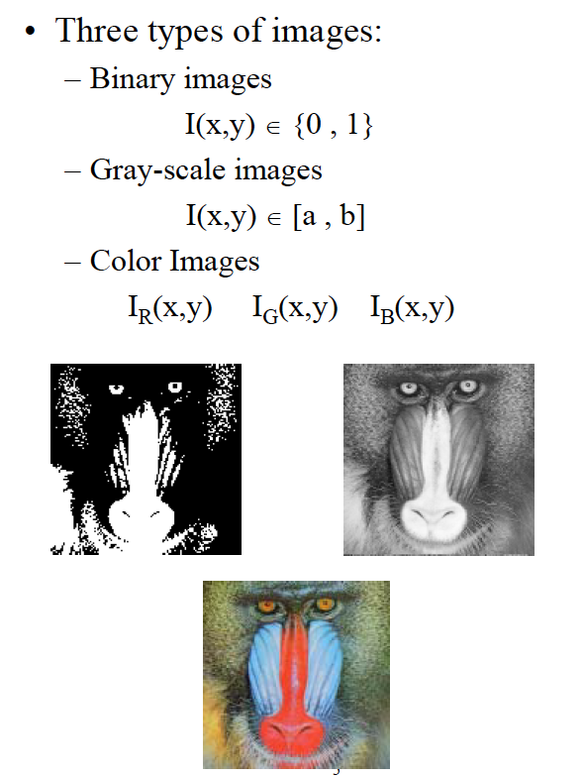
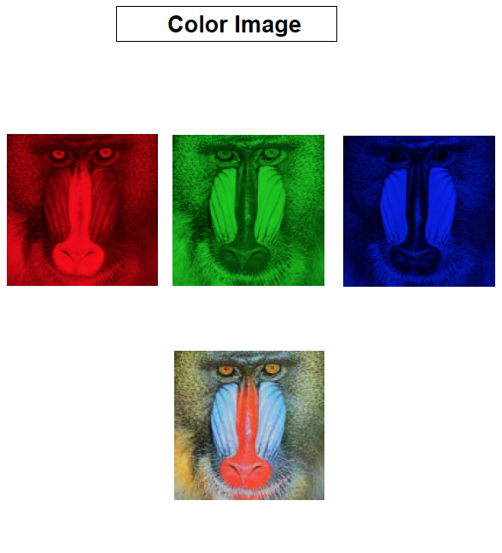
Pixel
Image Intensity -Light energy emitted from a unit area in the image.

Slide 4
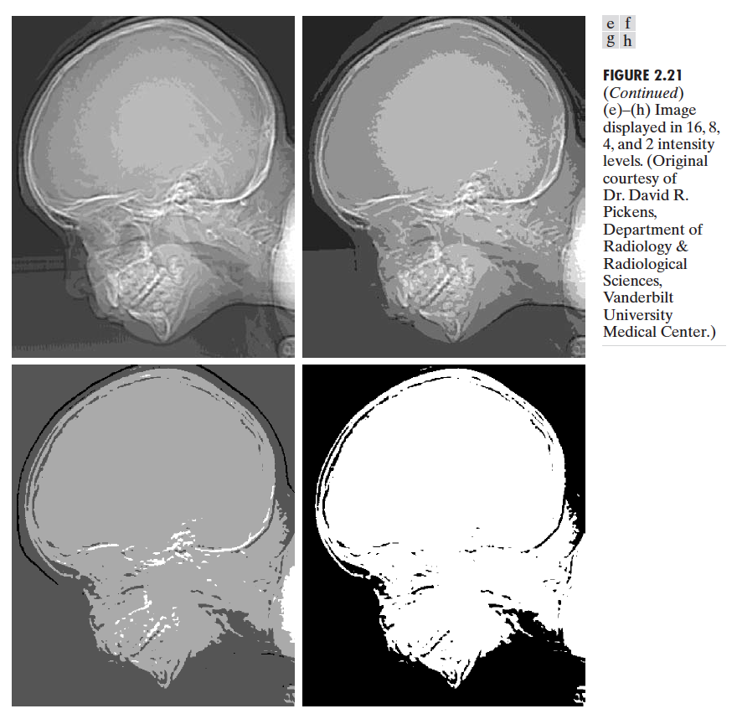
Pixel
Image Gray-Level – The relative intensity at each unit area. Between the lowest intensity (Black value) and the highest intensity (White value).

Slide 5

Pixel
Image Gray-Level – The relative intensity at each unit area. Between the lowest intensity (Black value) and the highest intensity (White value).
What are M, N, and k?

Slide 6
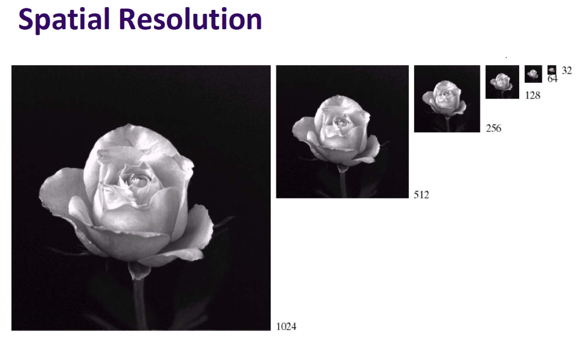
Pixel

Slide 7
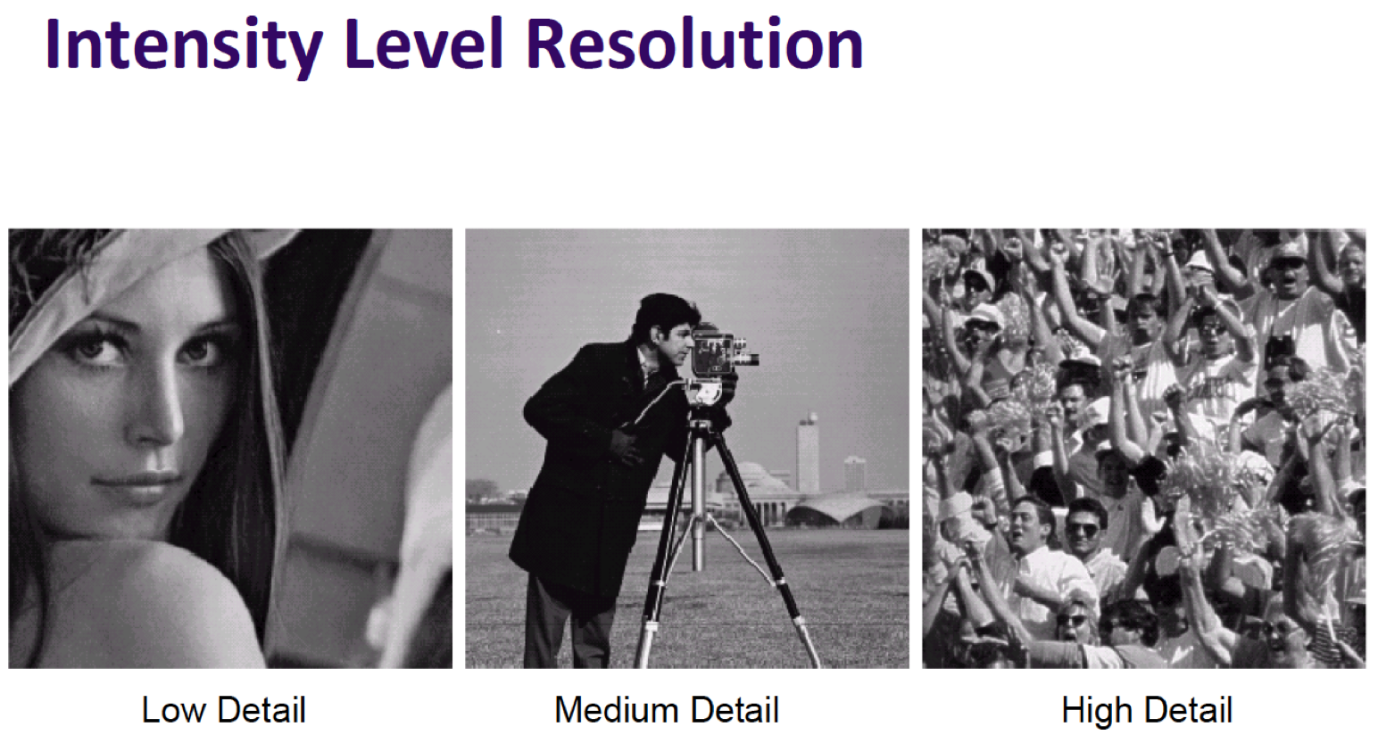
Pixel

Slide 8
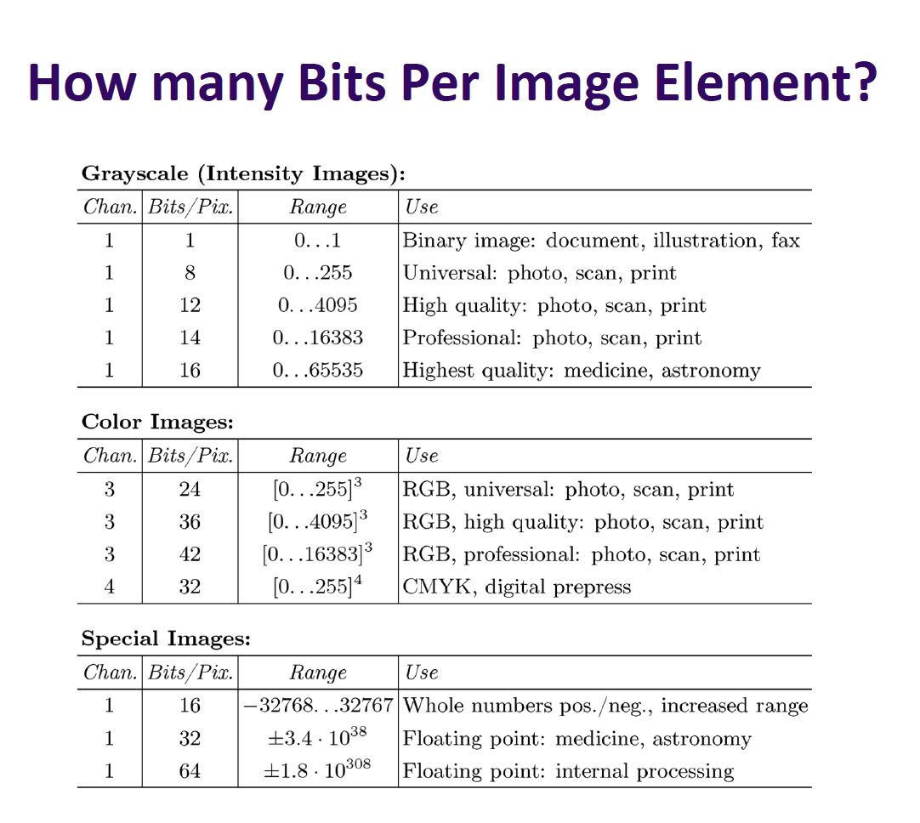
Pixel

Slide 9
Basic Relationships Between Pixels
Neighbors of a pixel p at coordinates (x,y)
4-neighbors of p, denoted by N₄(p):
(x-1, y), (x+1, y), (x,y-1), and (x, y+1).
4 diagonal neighbors of p, denoted by N_{D}(p):
(x-1, y-1), (x+1, y+1), (x+1,y-1), and (x-1, y+1).
8 neighbors of p, denoted N₈(p)
N₈(p) = N₄(p) U N_{D}(p)

Slide 10
Basic Relationships Between Pixels
Adjacency
Let S be the set of intensity values
4-adjacency: Two pixels p and q with values from S are 4-adjacent if q is in the set N₄(p).
8-adjacency: Two pixels p and q with values from S are 8-adjacent if q is in the set N₈(p).

Slide 11
Examples: Adjacency and Path
Basic Relationships Between Pixels
01,1 11,2 11,3 0 1 1 0 1 1
02,1 22,2 02,3 0 2 0 0 2 0
03,1 03,2 13,3 0 0 1 0 0 1
If S = {1, 2}, then
Adjacency between (1,3) and (3,3)
Path : (1,3), (1,2), (2,2), (3,3)

Slide 12
Basic Relationships Between Pixels
Connected in S
Let S represent a subset of pixels in an image. Two pixels p with coordinates (x₀, y₀) and q with coordinates (x_{n}, y_{n}) are said to be connected in S if there exists a path
(x₀, y₀), (x₁, y₁), …, (x_{n}, y_{n})
Where

Slide 13
Basic Relationships Between Pixels
Let S represent a subset of pixels in an image
For every pixel p in S, the set of pixels in S that are connected to p is called a connected component of S.
If S has only one connected component, then S is called Connected Set.
We call R a region of the image if R is a connected set
Two regions, R_{i} and R_{j} are said to be adjacent if their union forms a connected set.
Regions that are not to be adjacent are said to be disjoint.

Slide 14
Basic Relationships Between Pixels
Boundary (or border)
The boundary of the region R is the set of pixels in the region that have one or more neighbors that are not in R.
If R happens to be an entire image, then its boundary is defined as the set of pixels in the first and last rows and columns of the image.
Foreground and background
An image contains K disjoint regions, R_{k}, k = 1, 2, …, K. Let R_{u} denote the union of all the K regions, and let (R_{u})^{c} denote its complement.
All the points in R_{u} is called foreground;
All the points in (R_{u})^{c} is called background.

Slide 15
Question 1
Basic Relationships Between Pixels
In the following arrangement of pixels, are the two regions (of 1s) adjacent? (if 8-adjacency is used)
1 1 1
1 0 1
0 1 0
0 0 1
1 1 1
1 1 1
Region 1
Region 2

Slide 16
Question 2
Basic Relationships Between Pixels
In the following arrangement of pixels, are the two parts (of 1s) adjacent? (if 4-adjacency is used)
1 1 1
1 0 1
0 1 0
0 0 1
1 1 1
1 1 1
Part 1
Part 2

Slide 17
Basic Relationships Between Pixels
Question 2
In the following arrangement of pixels, are the two parts (of 1s) adjacent? (if 4-adjacency is used)
1 1 1
1 0 1
0 1 0
0 0 1
1 1 1
1 1 1
Region 1
Region 2

Slide 18
Basic Relationships Between Pixels
Question 3
In the following arrangement of pixels, the circled point is part of the boundary of the 1-valued pixels if 8-adjacency is used, true or false?
0 0 0 0 0
0 1 1 0 0
0 1 1 0 0
0 1 1 1 0
0 1 1 1 0
0 0 0 0 0

Slide 19
Basic Relationships Between Pixels
Question 4
In the following arrangement of pixels, the circled point is part of the boundary of the 1-valued pixels if 4-adjacency is used, true or false?
0 0 0 0 0
0 1 1 0 0
0 1 1 0 0
0 1 1 1 0
0 1 1 1 0
0 0 0 0 0

Slide 20
Distance Measures
Given pixels p, q and z with coordinates (x, y), (s, t), (u, v) respectively, the distance function D has following properties:
D(p, q) ≥ 0 [D(p, q) = 0, if p = q]
D(p, q) = D(q, p)
D(p, z) ≤ D(p, q) + D(q, z)

Slide 21
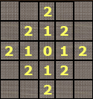
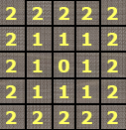
Distance Measures
The following are the different Distance measures:
Euclidean Distance :
D_{e}(p, q) = [(x-s)² + (y-t)²]^{1/2}
City Block Distance:
D₄(p, q) = |x-s| + |y-t|
Chess Board Distance:
D₈(p, q) = max(|x-s|, |y-t|)

Slide 22
Distance Measures
Question 5
In the following arrangement of pixels, what’s the value of the chessboard distance between the circled two points?
0 0 0 0 0
0 0 1 1 0
0 1 1 0 0
0 1 0 0 0
0 0 0 0 0
0 0 0 0 0

Slide 23
Distance Measures
Question 6
In the following arrangement of pixels, what’s the value of the city-block distance between the circled two points?
0 0 0 0 0
0 0 1 1 0
0 1 1 0 0
0 1 0 0 0
0 0 0 0 0
0 0 0 0 0

Slide 24
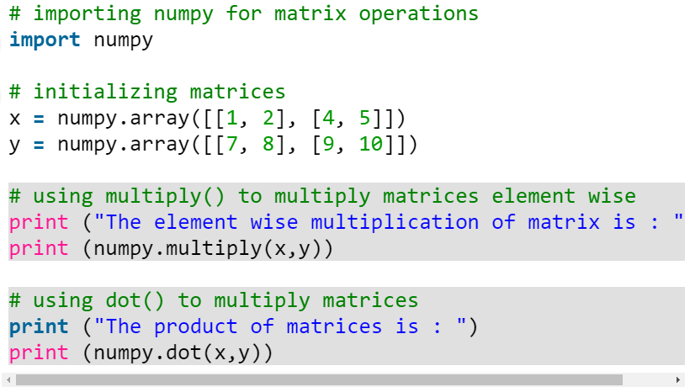
Python matrix operation

Slide 25
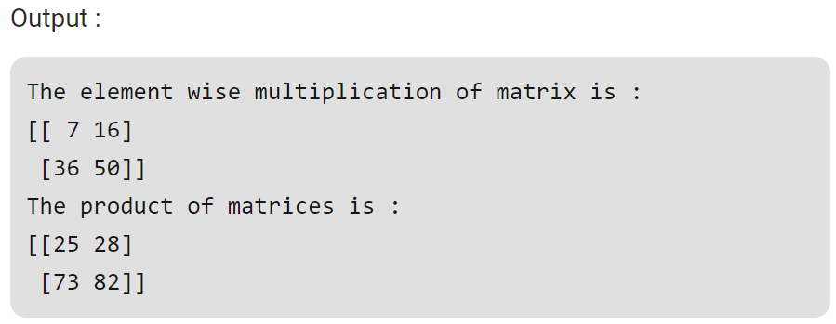
Python matrix operation

Slide 26
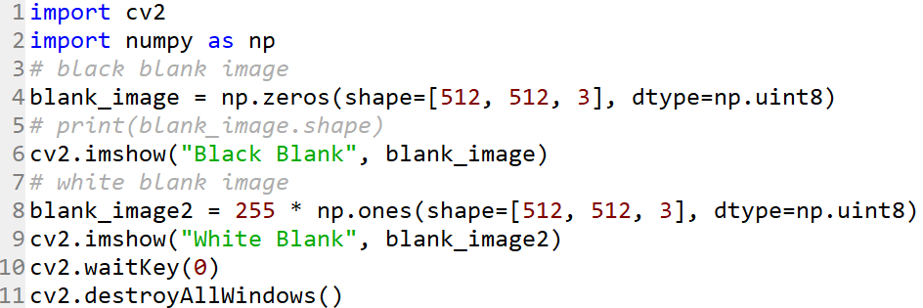
Exercise

Slide 27
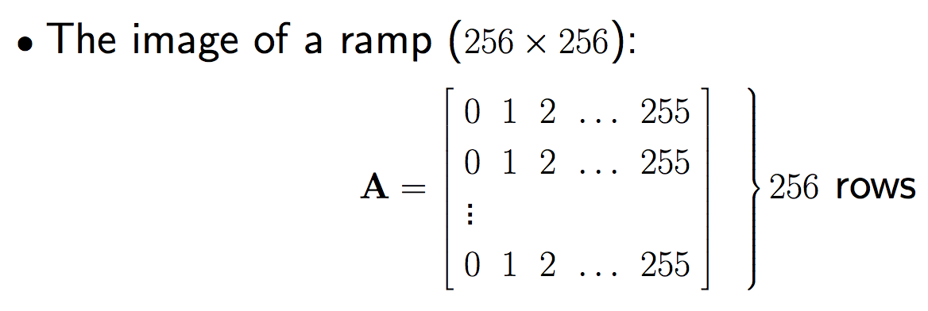

Exercise 1

Slide 28
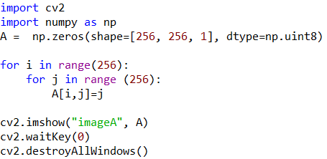
Exercise 1

Slide 29

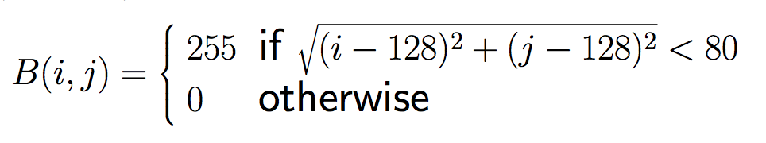

Exercise 2

Slide 30
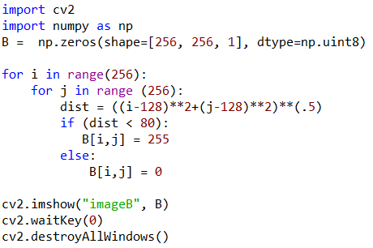
Exercise 2

Slide 31



Assignment 1
Assignment 1 (get to know Python and OpenCV and show one image)
Download and install Python and OpenCV package
Practice the exercises
Modify your own image and emphasis the center part by making the pixels outside the circle to be black. You could set circle radius to any value.

